Slide 1
Contrastive loss + GAN-based image manipulation
Wonyl Choi
Minh Nguyen
Quan Pham

Slide 2
Outline
An introduction to the task you are solving: What is image attribute manipulation?
What the goal of your project is: GAN-based attribute manipulation + Contrastive Loss
GAN-based attribute manipulation
State of the Art Models
Contrastive Loss
The current status / results for your project
Dataset
The current status
StarGAN
AttGAN
StyleGAN2
The plan for the remaining semester

Slide 3
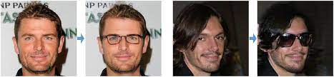
Image Attribute Manipulation
Translating an input image to a new realistic image that has a certain subset of attributes modified as desired, while the rest remains as the original.

Slide 4
2. Goal of the Projects
GAN-based attribute manipulation
+ Contrastive Loss
Contrastive Learning
Generator Loss
Manipulation Labels
Real
Image
G
D
Attr. Classification
Manipulated
Image
Real/Synth.
True Labels
Discrementator Loss
Notes:
Add the contrastive loss to the generator’s loss. Make the representations of images with the same label closer. While doing so, learn the conditional representation for each attributes.

Slide 5
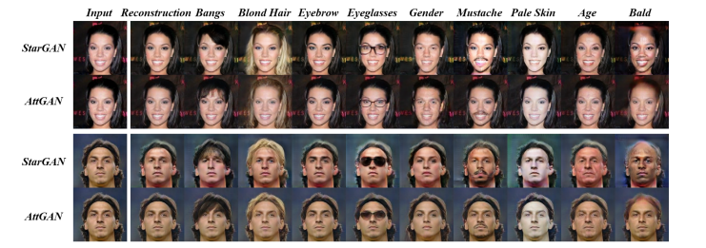
2.1.1. State of the Art Models
He, Zhenliang, et al. "Attgan: Facial attribute editing by only changing what you want." IEEE transactions on image processing 28.11 (2019): 5464-5478.

Slide 6
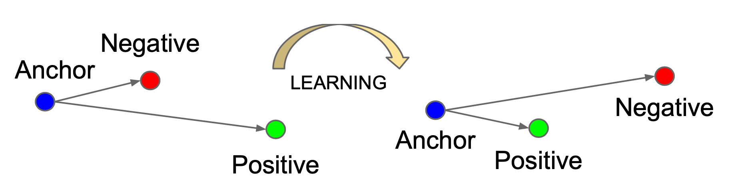
2.2. Contrastive Loss
Compare pairs of samples and encourage the model to learn to distinguish between them.
e.g.) InfoNCE takes a positive pair and random samples and minimize the distance between the positive pairs to be distinguishable to the random samples.

Slide 7
2. Goal of the Projects
GAN-based Image manipulation
+ Contrastive Loss
Attribute Vectors
Person1, Img1
Identity ⊥ Attribute
Disentangle
Pull identity closer for modified images
Attributes must be aligned according to labels
Pull the similar attribute components closer
Push the different attribute components apart
Person2, Img1
Identity Vector 1
Same Person,
Same Identity
Identity Vector 1
Identity Vector 2
Person1, Img2
Same Attributes
Notes:
Add the contrastive loss to the generator’s loss. Make the representations of images with the same label closer. While doing so, learn the conditional representation for each attributes.

Slide 8
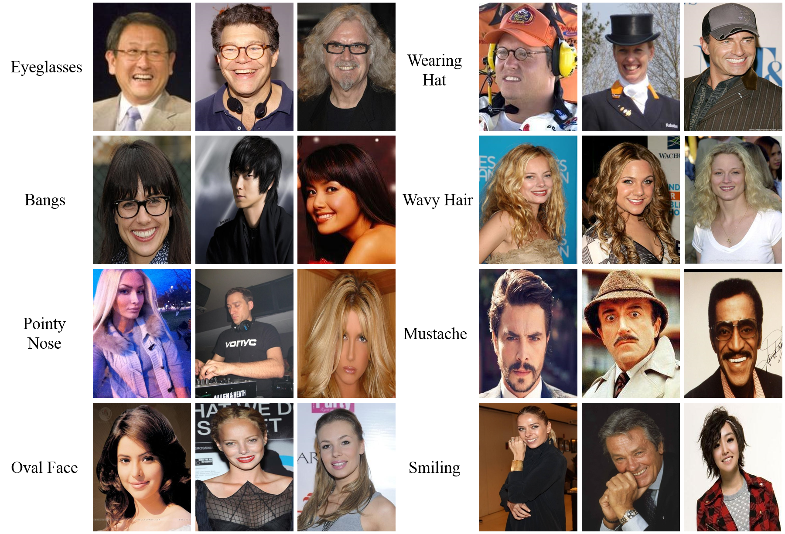
3.1. Dataset
CelebA (~200k images, 40 Attributes)
Notes:
CelebA: Large-scale face attributes dataset with over 200,000 celebrity images.
Each image annotated with 40 binary attributes such as gender, age, and facial expression
Widely used in the field of computer vision for facial attribute recognition and generation tasks
The dataset contains local, global, and abstract attributes of 40 kinds annotated on 202,599 face images and 10,177 identities

Slide 9
3.2. Current Progress
StarGAN
Fine-tuned on CelebA
Incorporating InfoNCE loss in progress - Penalize the generator’s loss with InfoNCE loss.
Computed FID scored of the generated images through Inception3 model. (16.5)
AttGAN
Retrained on CelebA
Incorporating InfoNCE loss in progress - Penalize the generator’s loss with InfoNCE loss.
Computed FID scored of the generated images (70.4)
StyleGAN2
Fine-tuned on CelebA
Training image encoder to solve the GAN inversion problem
Applying the contrastive loss to learn common attribute features among the sample images.

Slide 10
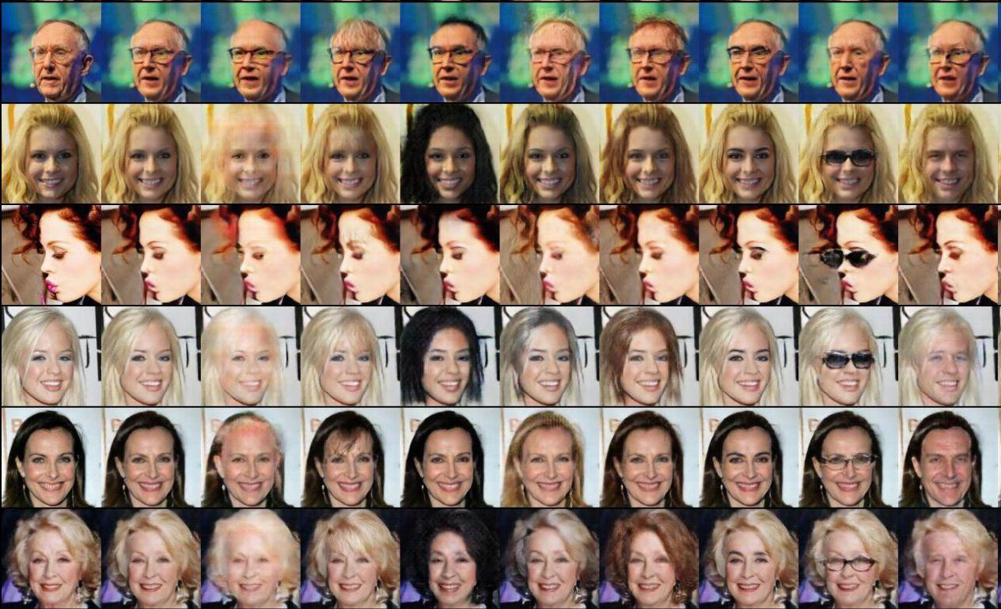
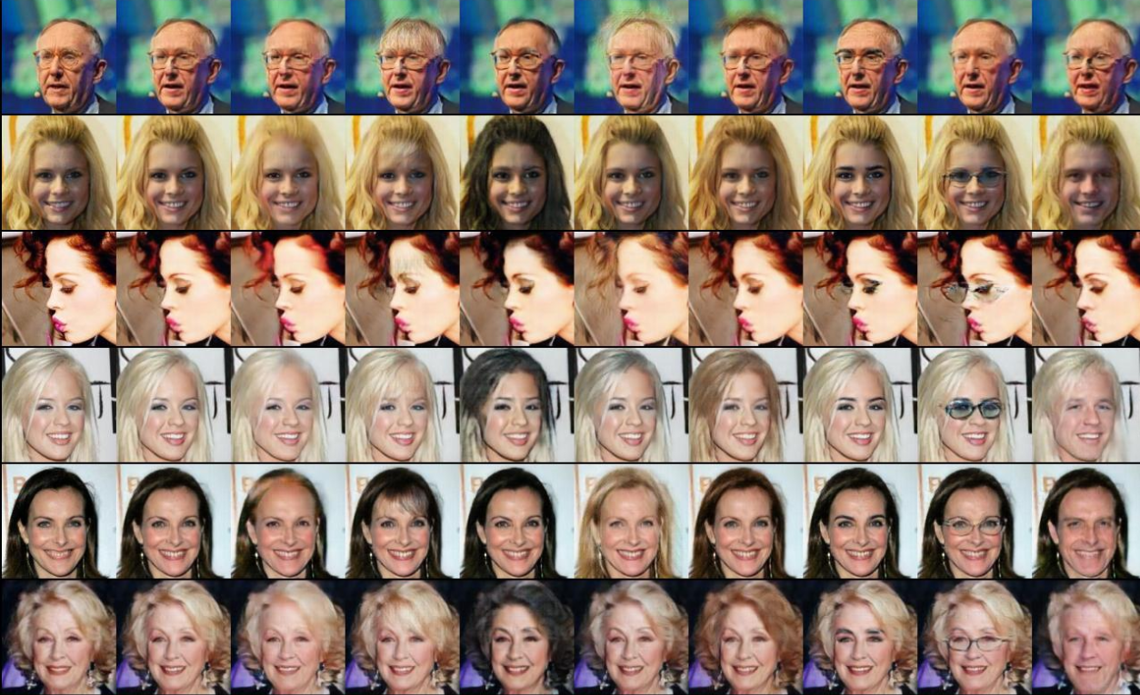
3.2. Current Progress
AttGAN + InfoNCE
AttGAN + InfoNCE loss
AttGAN
Input
Input

Slide 11
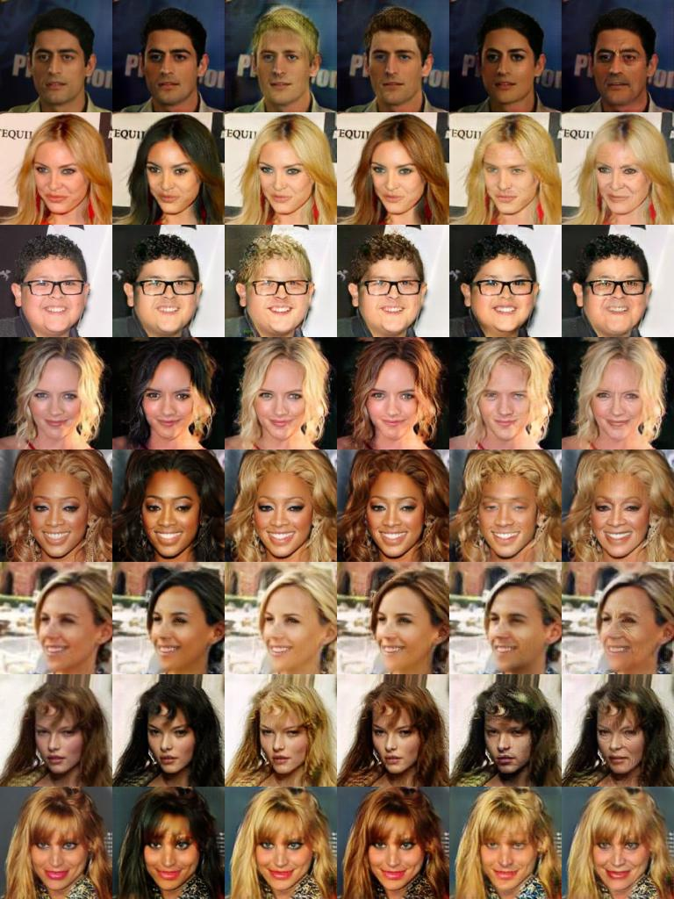
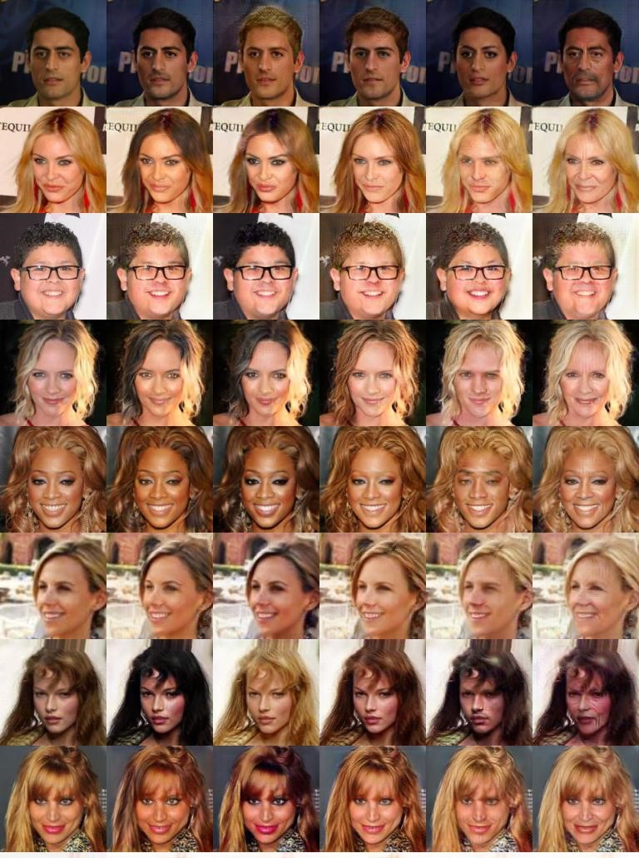
3.2. Current Progress
StarGAN (Fine-tuning)
Fine-tuned Results
Pretrained model
Notes:
Some improvements such as blond features. The goal was to compute the FID score and compare before and after applying the contrastive loss.

Slide 12
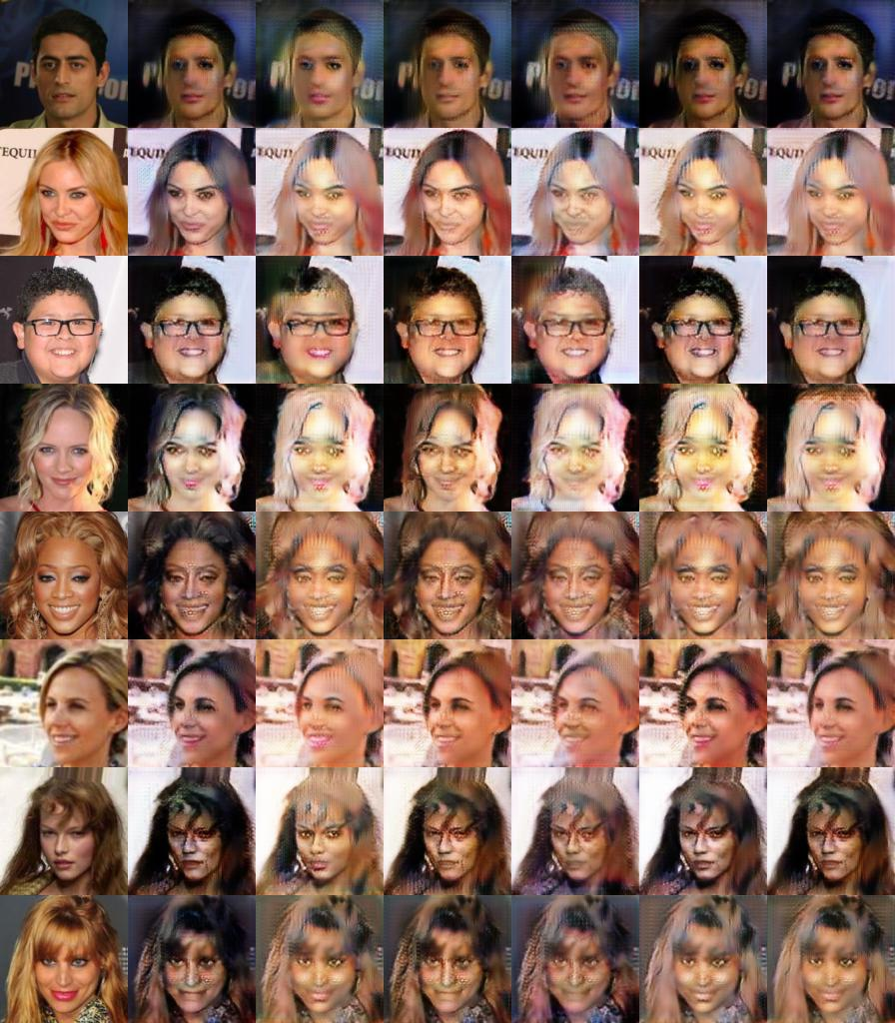
3.2. Current Progress
StarGAN + InfoNCE
Computing contrastive loss on the original attributes and the classification attributes output by the discriminator.
Classifier output closer to the original label than the target must be penalized. (Current implementation has the sign reversed)

Slide 13
3.2. Current Progress
Attribute Manipulation with StyleGAN2
Synth. Image
D
Real Image
Z~Normal
G.mapping
w
G.synthesis
?
inversion problem
StyleGAN2
GAN-based model for generating realistic images
Uses progressive generation
Requires to solve the GAN inversion problem first to manipulate attribute of the real image
GAN Inversion Problem
(Noise → Image) → Image Embedding
Once the embedding space is learned, the attribute manipulation can be done by navigate the embedding space with the given condition

Slide 14
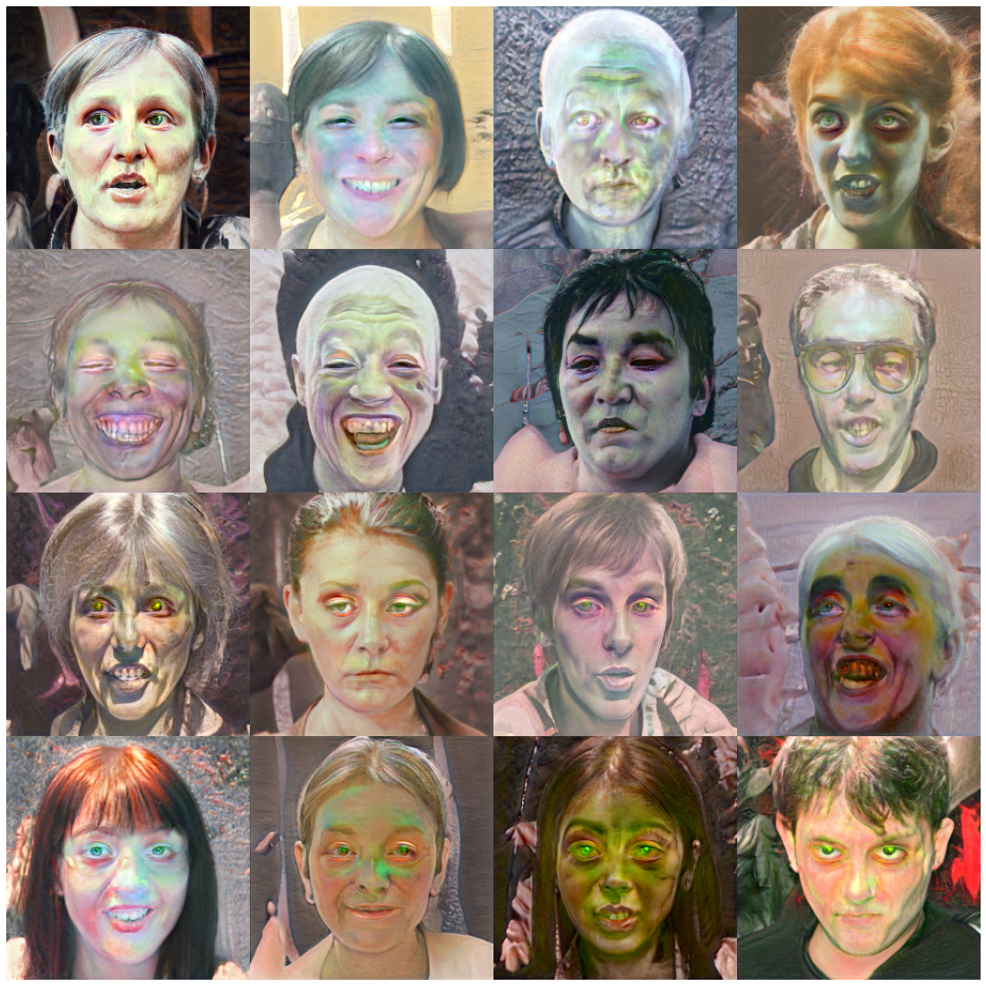
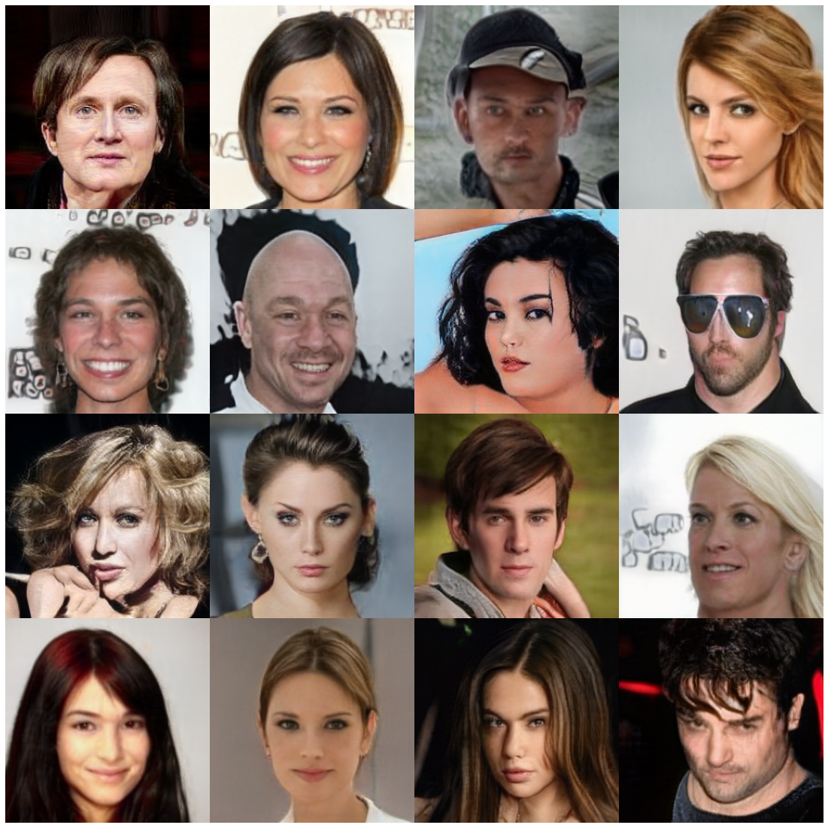
3.2. Current Progress StyleGAN2 Fine-tuning
(Output of Pretrained Model on FFHQ256)
(Synthesized Images, After 110 Epoches, ~48hrs)

Slide 15
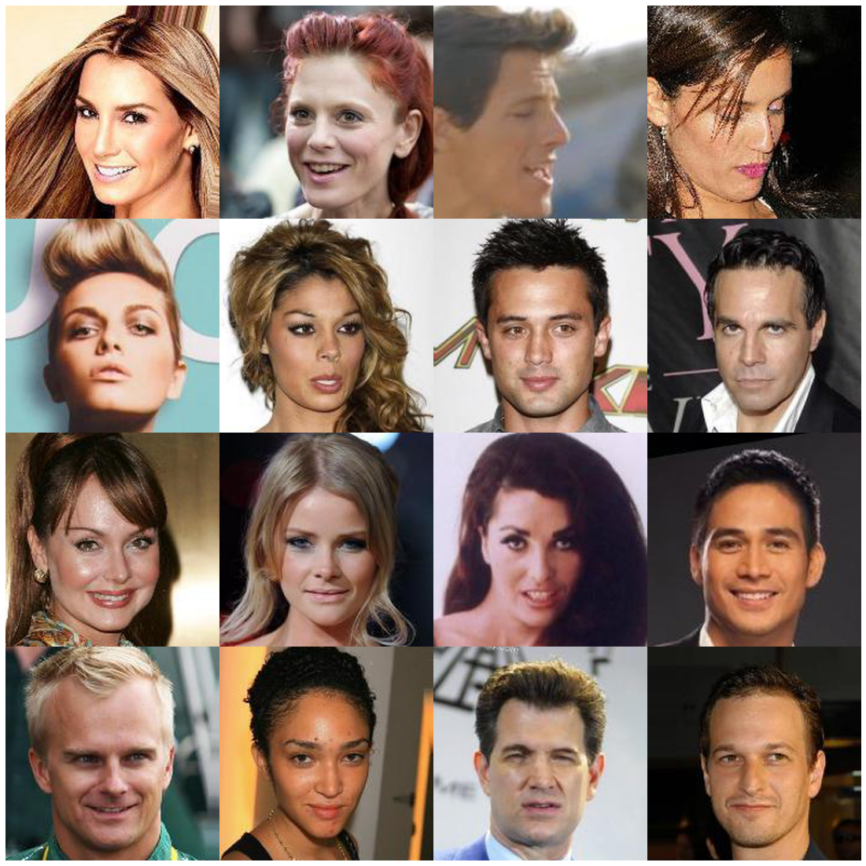
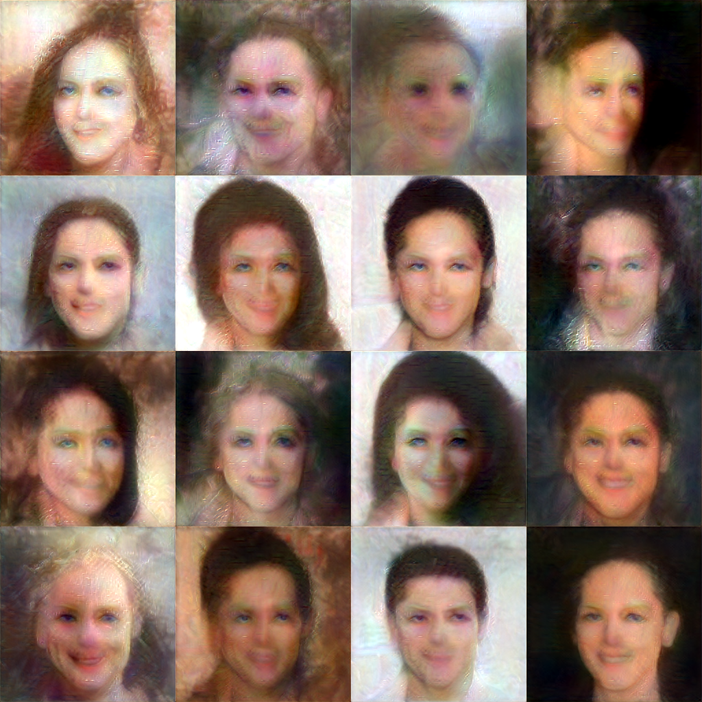
Inversion of StyleGAN2
Real Images
Real Image
Embedding
Synth. Image
Image Encoder
Generator.eval()
(StyleGAN2)
VGG16.eval()
Approach 1. : Learn the encoder
Create an encoder with VGG16 Backbone
Use pre-trained VGG16 for feature extraction
Make generated image feature to be closer to the target image input
+ Pixel-wise loss
Problems
Does not generates realistic images
Learns up to the power of pre-trained VGG16
Not all the d-dim space are valid inputs
High cost
Exploding gradient problem
Reconstruction
After 30 Epoches (~6hrs)

Slide 16
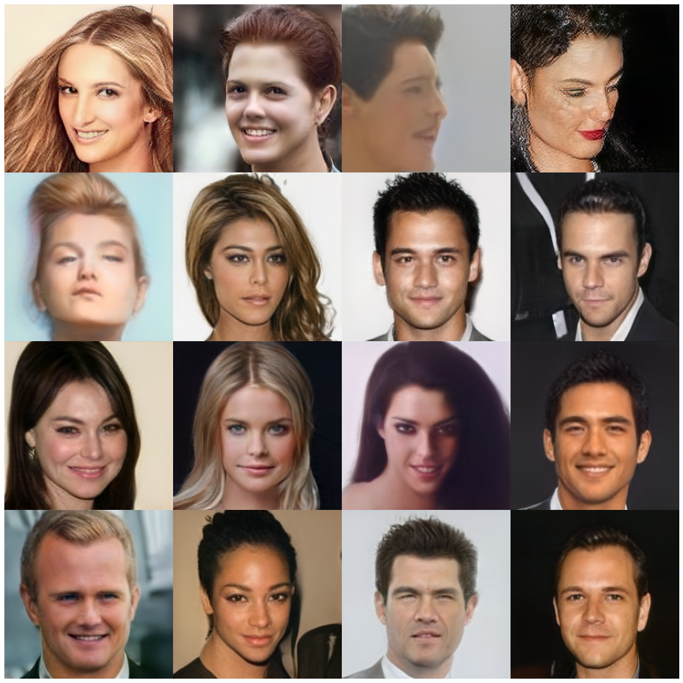
Inversion of StyleGAN2
Real Images
Real Image
Embedding
Synth. Image
Image Encoder
Generator.eval()
(StyleGAN2)
VGG16.eval()
Approach 2. : Overfitting Image Embeddings
Use pre-trained VGG16 for feature extraction
Same loss as Approach 1, but learn the embedding vector directly.
Problems
Does not generalize: Only embedding of the target image can be earned, not the mapping function
Time cost is high, especially for the service scenario
Reconstruction after 256 Iter.

Slide 17
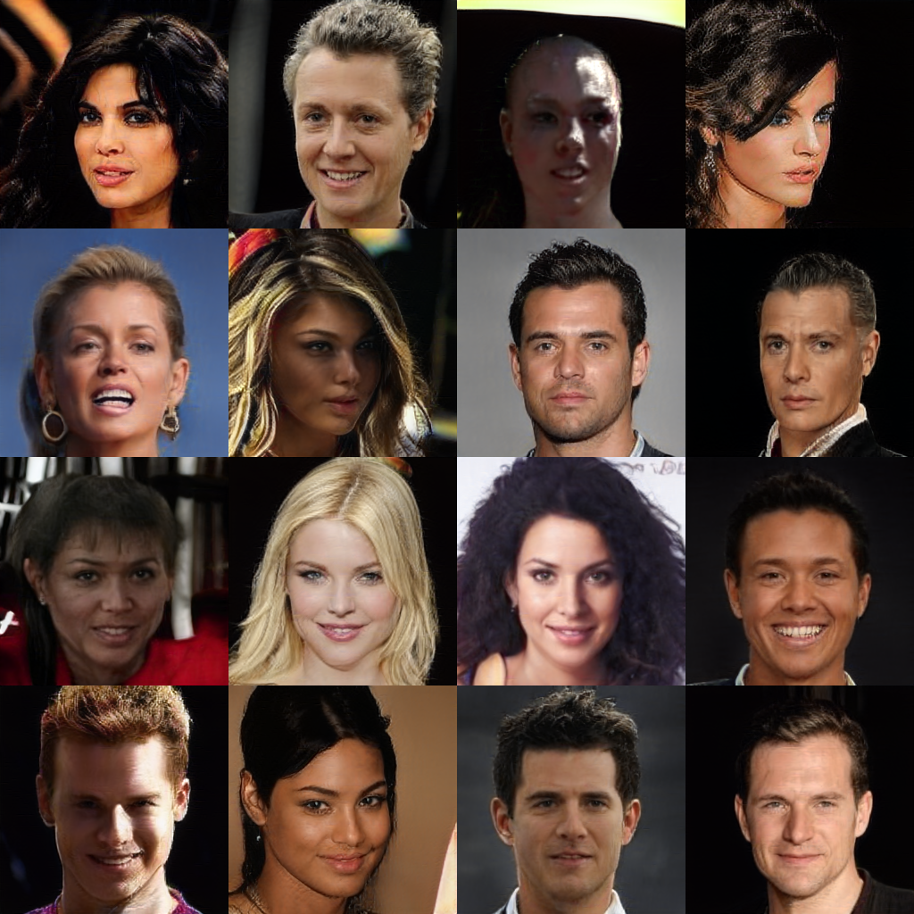
Inversion of StyleGAN2
Inversion of StyleGAN2
Target Images
Loss
z~Normal
Synth. Image
G.mapping
w
G.synthesis
Image Encoder
w’
Approach 3 : Reverse
Training with random noise.
G.mapping ensures to learn the space of realistic image embedding
Problems
Missing the embedding space of the real image
Image Encoder is many-to-one map (dimension)
Realistic
Embeddings
Reconstructing
embeddings
!
Reconstruction
after 8576 iter.

Slide 18
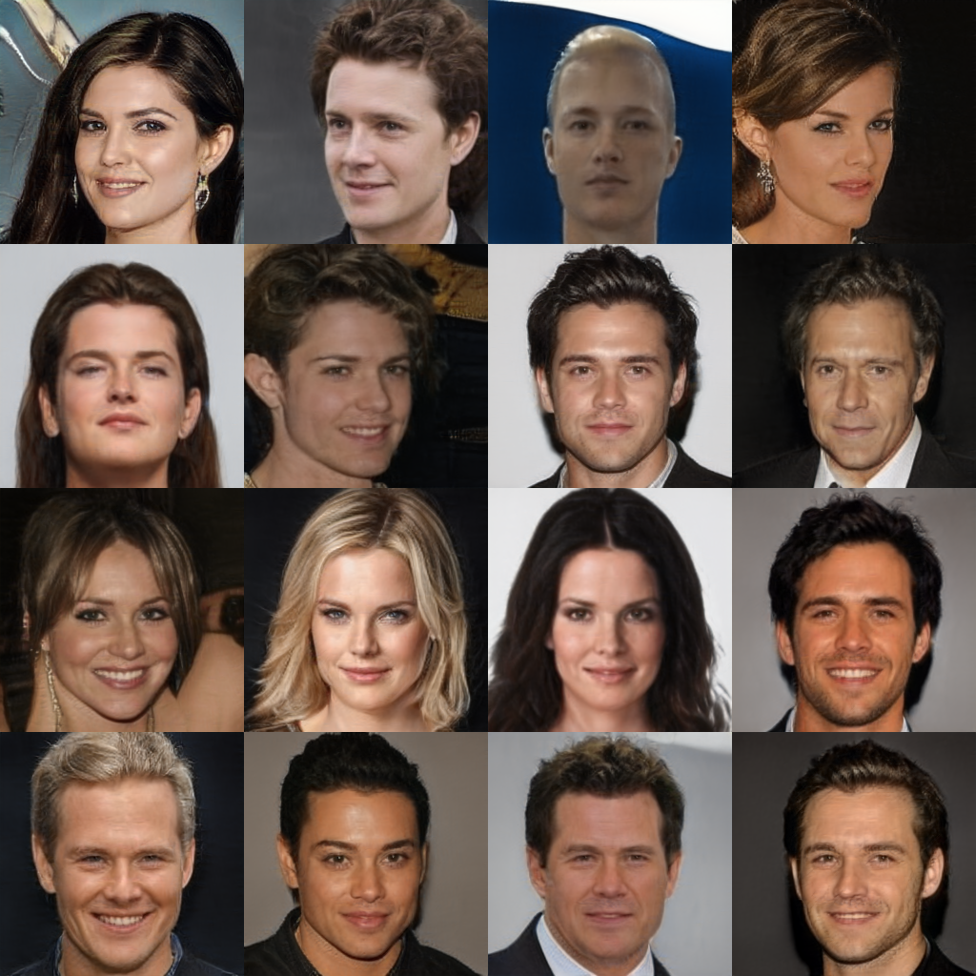
Inversion of StyleGAN2
Inversion of StyleGAN2
Target Images
Loss
z~Normal
Synth. Image
G.mapping
w
G.synthesis
Statistics from
Pretrained
Embedding
Image Encoder
w’
Approach 3.1 : Reverse with statistics
Training with random noise, but now modify moments of w to be matched to the statistics of the pretrained embedding
Current implementation: Matching 2st moment, alter 1st as convex combination.
Problems
Still not there yet!
Reconstruction
after 8576 iter.

Slide 19
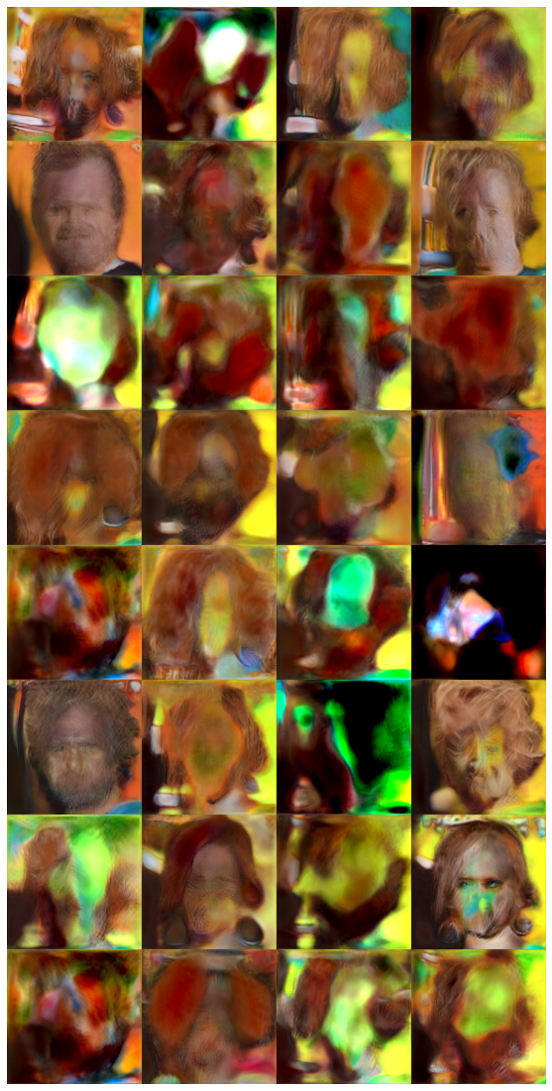
Navigating the Embedding Space of StyleGAN2
Attribute Vectors
Person1, Img1
Person2, Img1
In progress…
Identity Vector 1
Same Person,
Same Identity
(not implemented)
Identity Vector 1
Identity Vector 2
Person1, Img2
Same Attributes
→ extract attribute feature and maximize mutual info. (in progress)

Slide 20
4. Futurework
Bug-fix
Re-apply the contrastive loss to understand the embedding space of the image
Try the contrastive loss to train the discriminator.
Re-calculate FID score on a larger amount of images for the normal aforementioned GAN structures with contrastive loss.

Slide 21
References
He, Zhenliang, et al. "AttGAN: Facial attribute editing by only changing what you want." IEEE transactions on image processing 28.11 (2019): 5464-5478.
Choi, Yunjey, et al. "Stargan: Unified generative adversarial networks for multi-domain image-to-image translation." Proceedings of the IEEE conference on computer vision and pattern recognition. 2018.
Karras, Tero, et al. "Analyzing and improving the image quality of stylegan." Proceedings of the IEEE/CVF conference on computer vision and pattern recognition. 2020.
Liu, Ziwei, et al. "Deep learning face attributes in the wild." Proceedings of the IEEE international conference on computer vision. 2015.

Slide 22
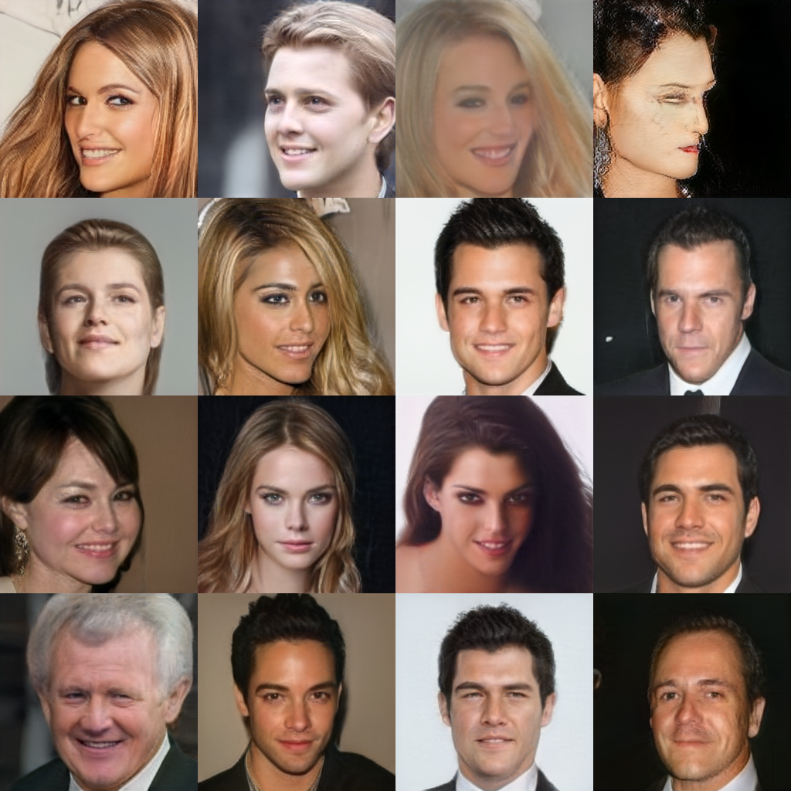
Inversion of StyleGAN2
Inversion of StyleGAN2
Target Images
Real Image
Embedding
Image Encoder
Generator.eval()
(StyleGAN2)
Pretrained
Embedding
Approach 2.2 : Train Encoder with Target Embeddings
Learn the embeddings first, and then train the encoder.
Generates more realistic image than Approach 1. & 2.
Problems
Overfitting (not reliable for images without target)
Underfitting (does not reproduce the target embedding)
Reconstruction
after 200 Epoches

Slide 23
Encoder
Encoder
(Identity)
w
μ
p_T
a
Linear
Projection
p
a_M
p_M
w’

